Slide 1
Data Extractors:
Team Charter
Austin Meredith
Chris Mendoza
David Garcia
Luis Carrillo
Mason Lanham

Slide 2
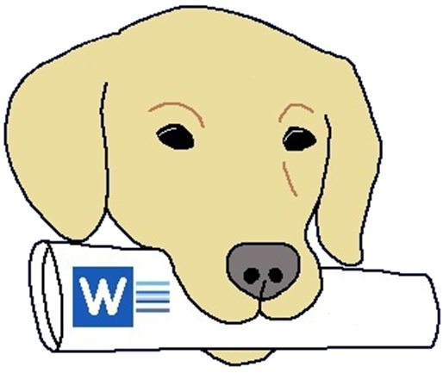
The Data Extractors
Project: Develop a software application in Python that can read and output text from any Microsoft Word document
Our Motto: “If Microsoft can Doc it, we can extract it.”
Our Vision: Efficiently Extracting Data through Precise Programming.
Our team mascot, Peaches
(Austin’s Dog)

Slide 3
Our Mission and Goals
Mission:
To better our understanding of the Software Development Process and work together as a team to create an excellent word data extractor.
Goals:
A complete, well-documented, efficiently functioning word data extractor developed by consistently producing quality work with measured results.
We’ll measure this through Bi-Weekly Progress Reports with the following questions:
Are we keeping up with our documentation?
Are we following our charter?
Do our individual evaluations show progress toward our goal?

Slide 4
Team Roles
Meeting Roles:
Coordinator - Mason
Scribe - David
Time Keeper - Luis
Facilitator - Austin
Project Roles:
Project Manager - Mason
Editors and Production Managers - Mason, David
Research Managers - David, Luis, Chris
Repository Managers - Chris, Austin
Graphics and Presentations - Austin, Luis
Communication Administrators - Austin, Mason

Slide 5
Ground Rules
Administrative/Meetings
The team will meet each Thursday at 6PM in the SSCB.
Team can also meet on Tuesday at 6PM if needed. Whether or not we will meet on Tuesdays will be decided by a majority vote from the team.
Tardiness at team meetings will be penalized by -15 points off of their “Social Credit Score” for every 15 minutes that a member is late. The Social Credit Score will go on to affect our evaluations of our group members.
Decision-Making
Team will make decisions by a consensus, if possible
If a consensus cannot be reached, a majority vote will be held
When a new idea is added to our project we will round robin ensure that each member is on board with the new idea.

Slide 6
Ground Rules
Interpersonal
Team members will treat each other as professional computing colleagues.
Each team member will be treated with respect, but will also be expected to diligently work towards our common goal.
Settling Disagreements
In the case of a disagreement between team members, each person will have 24 hours to completely explain their position to the rest of the team.
If an agreement cannot be made between the disagreeing parties, then a compromise will be made by the members not involved in the disagreement.
If the compromise is not suitable, then a majority vote will be held including all members of the group to make the decision.

Slide 7
Procedures & Plans for Gathering Self-Assessment Data
Bi-weekly Progress Reports
Includes significant progress milestones, which member contributed what, etc.
Meeting Summaries
Along with meeting contribution scores
Weekly Individual and Team Reports
Useful for keeping track of how we spend our time and how we contribute to the team effort

Slide 8
-End Of Presentation-
We are looking forward to a successful semester!

